Slide 1
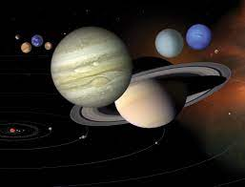
About universe
By Mahi Verma

Slide 2
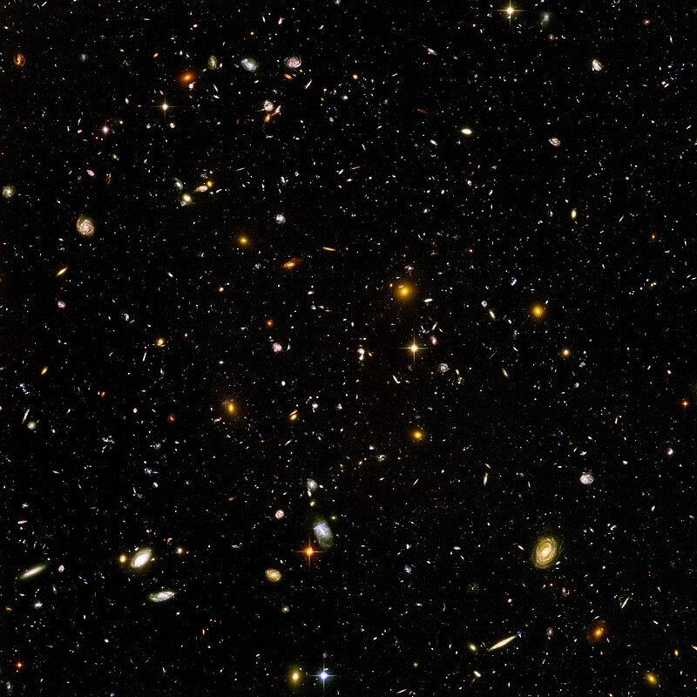
universe
The universe is all space and time and their contents. It comprises all of existence , any fundamental interaction , physical process and physical constant, and therefore all forms of energy and matter, and the structures they form, from sub-atomic particles to entire galaxies

Slide 3
Five facts about universe
1. There are more stars in the universe than grains of sand on all the beaches on Earth.
2. A black hole is created when big stars explode. Its gravitational force is so strong that nothing can escape from it – luckily the closest black hole is about 10,000 light-years from Earth.
3. When venturing into space, astronauts wear spacesuits which have to be warmed, cooled, pressurized and supplied with fresh air. This takes six hours for them to put on!
4. The universe has no center and is constantly expanding (getting bigger) every second – making
it impossible to reach the edge.
5. The Earth is about 4.5 billion years old – but that’s only a third of the age of the universe – which is 13.5 billion years old!

Slide 4
What is the universe made of?
The universe contains all the energy and matter there is. Much of the observable matter in the universe takes the form of individual atoms of hydrogen, which is the simplest atomic element, made of only a proton and an electron (if the atom also contains a neutron, it is instead called deuterium). Two or more atoms sharing electrons is a molecule. Many trillions of atoms together is a dust particle. Smoosh a few tons of carbon, silica, oxygen, ice, and some metals together, and you have an asteroid. Or collect 333,000 Earth masses of hydrogen and helium together, and you have a Sun-like star.

Slide 5
Thank You

